Slide 2
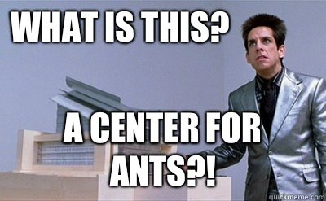
Center For Children Who Can’t OOP Good And Wanna Learn To Do Other Stuff Good Too
Kai C Gronborg
19 December 2018

Slide 3
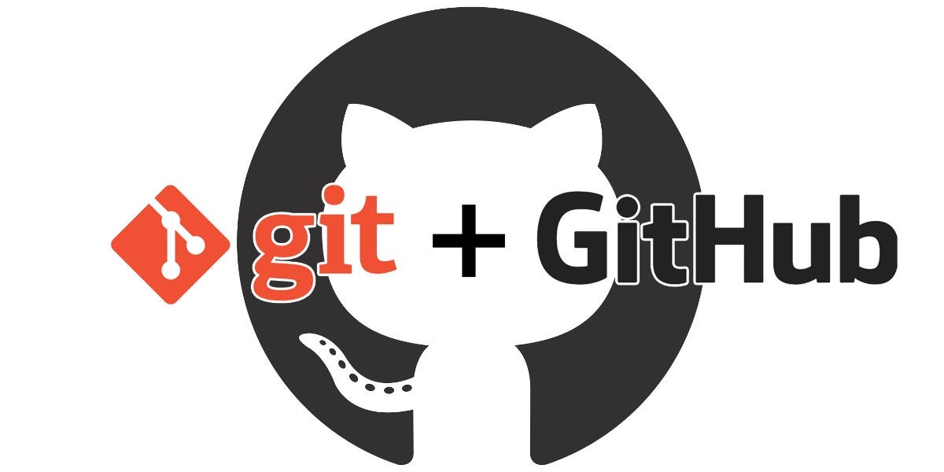
How Do We Keep A Detailed Record Of Our Code?
https://codeburst.io/git-version-control-system-github-54f4c2755372

Slide 4
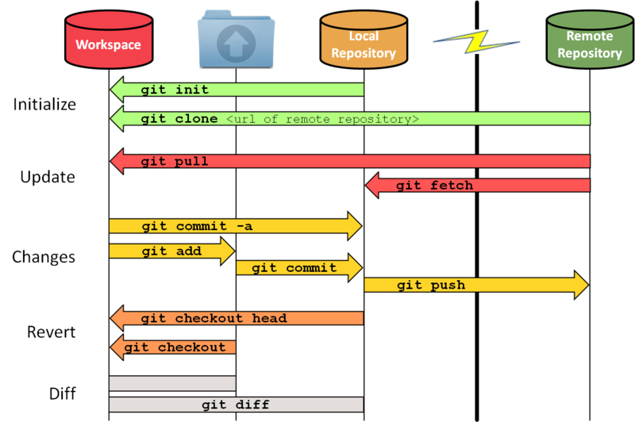


How Does Git Work?
https://sselab.de/lab2/public/wiki/sselab/index.php?title=Git

Slide 5
How Do We Setup A Git Repository From Scratch?
We need navigate to the directory you wish to hold your git repo using the terminal
$ cd /path/to/git/repo/
Initialize the git repo
$ git init

Slide 6
How Does Git Work?
https://sselab.de/lab2/public/wiki/sselab/index.php?title=Git

Slide 7
What If The Repository Already Exists On GitHub?
We need navigate to the directory you wish to hold your git repo using the terminal
$ cd /path/to/git/repo/
Clone the GitHub Repo
$ git clone <url_to_github_repo.com>

Slide 8
How Does Git Work?
https://sselab.de/lab2/public/wiki/sselab/index.php?title=Git

Slide 9
How Do I Update My Local Git Repo From GitHub?
You need to again cd to your local git repo using the terminal
$ cd /path/to/git/repo/
Pull the updates from the remote repo
$ git pull origin master

Slide 10
How Does Git Work?
https://sselab.de/lab2/public/wiki/sselab/index.php?title=Git

Slide 11
How Do I Make Sure My Local Repo Is Up-To-Date With My Local Workspace?
You need to again cd to your local git repo using the terminal
$ cd /path/to/git/repo/
Add file to be committed to the local repo
$ git add <filename>
Add all files in directory with:
$ git add .
Commit the files to the local repo
$ git commit -m "Comment About Commit"

Slide 12
How Does Git Work?
https://sselab.de/lab2/public/wiki/sselab/index.php?title=Git

Slide 13
Now That I Have My Local Repo Caught Up, How Do I Add Changes To Remote Repo (GitHub)?
You need to again cd to your local git repo using the terminal
$ cd /path/to/git/repo/
Push changes to remote repo
$ git push origin master

Slide 14
How Does Git Work?
https://sselab.de/lab2/public/wiki/sselab/index.php?title=Git

Slide 15
How Do I Undo Changes/Commits?
Follow these steps
$ git reset --soft HEAD~1 # Back to staging
$ git reset HEAD file.html # back to working directory
$ git checkout -- file.html # cancel changes

Slide 16
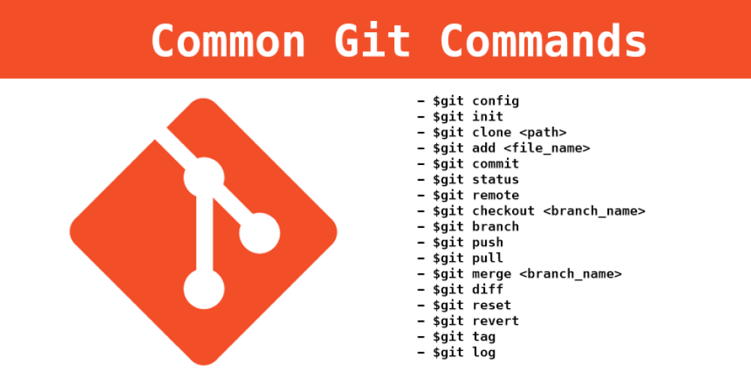
https://dev.to/neshaz/git-commands-ultimate-tutorial-part-2-7ko

Slide 17
There Are A Lot Of Tutorials Online
Codecademy: https://www.codecademy.com/learn/learn-git
Attlasian: https://www.atlassian.com/git/tutorials
Lynda: https://www.lynda.com/Git-training-tutorials/1383-0.html

Slide 18
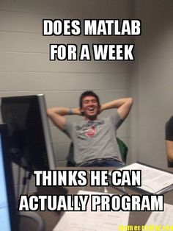

Slide 19
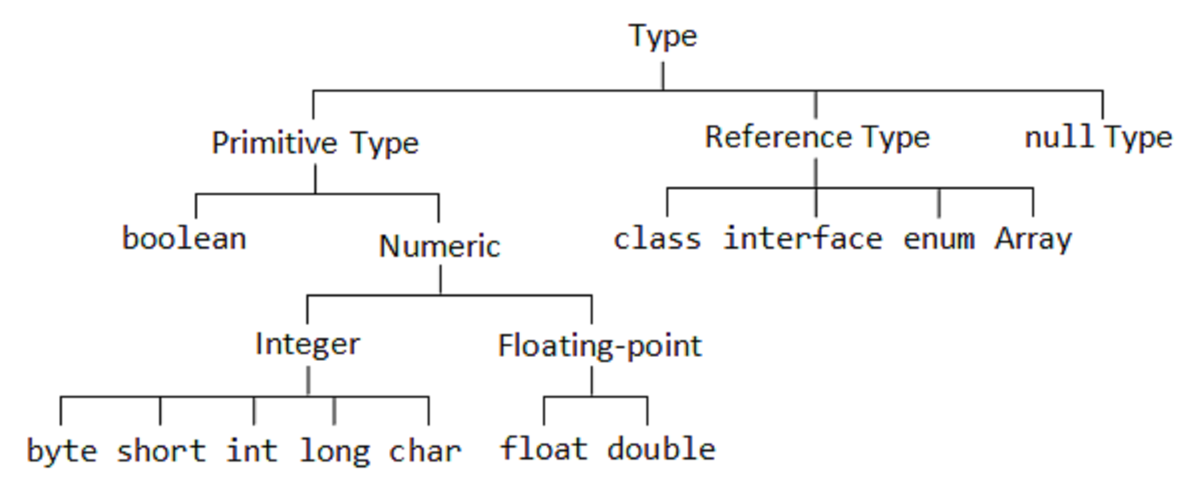
There Are Many Different Types Of Variables
https://javarevisited.blogspot.com/2015/09/difference-between-primitive-and-reference-variable-java.html

Slide 20
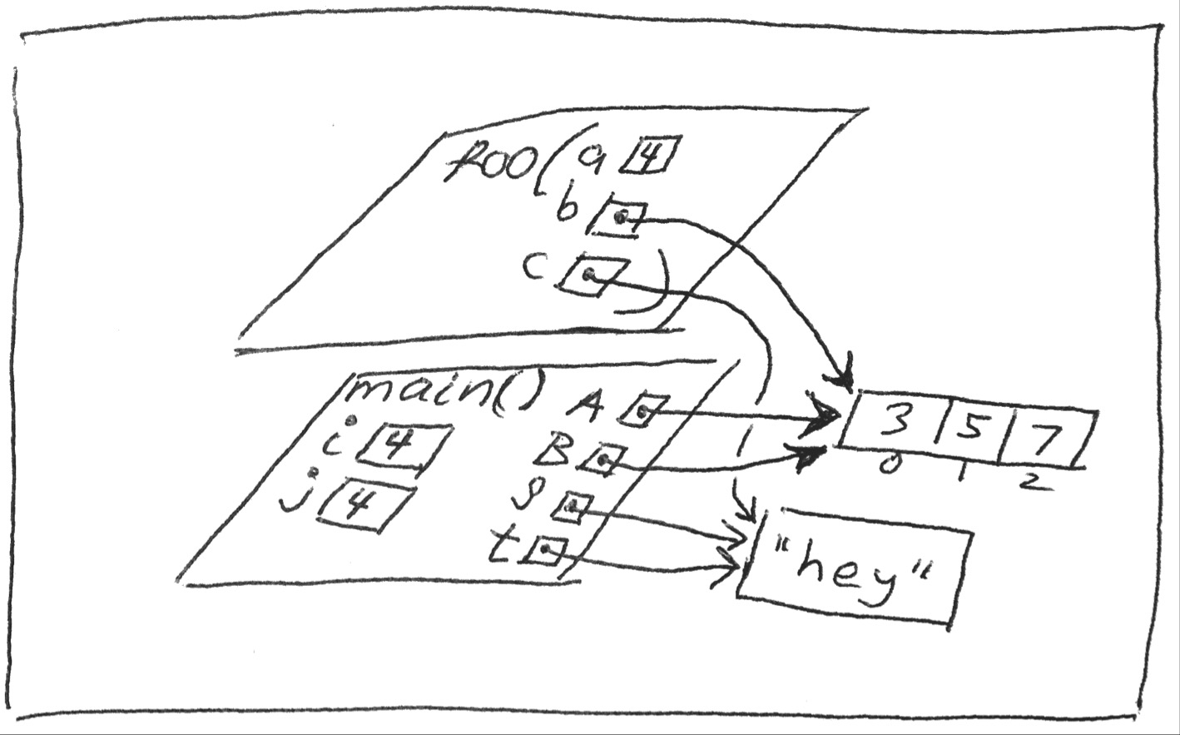

Slide 21
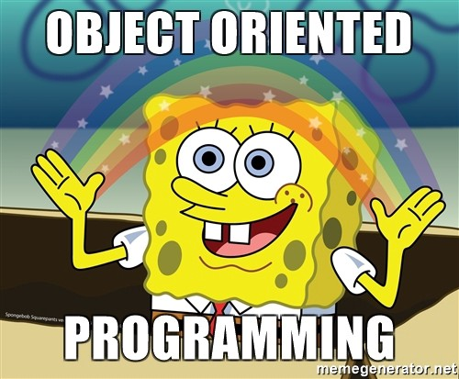

Slide 22
Programming Paradigms
Imperative: The programmer tells the computer how to change its state
Procedural: groups instructions into procedures
Object-oriented: groups instructions together with the part of the state they operate on
Declarative: The programmer declares properties of the desired result but not how to compute it
Functional: the desired result is declared as the value of a series of function applications
Logic: the desired result is declared as the answer to a question about a system of facts and rules
Mathematical: the desired result is declared as the solution of an optimization problem
https://www.wikiwand.com/en/Programming_paradigm

Slide 23
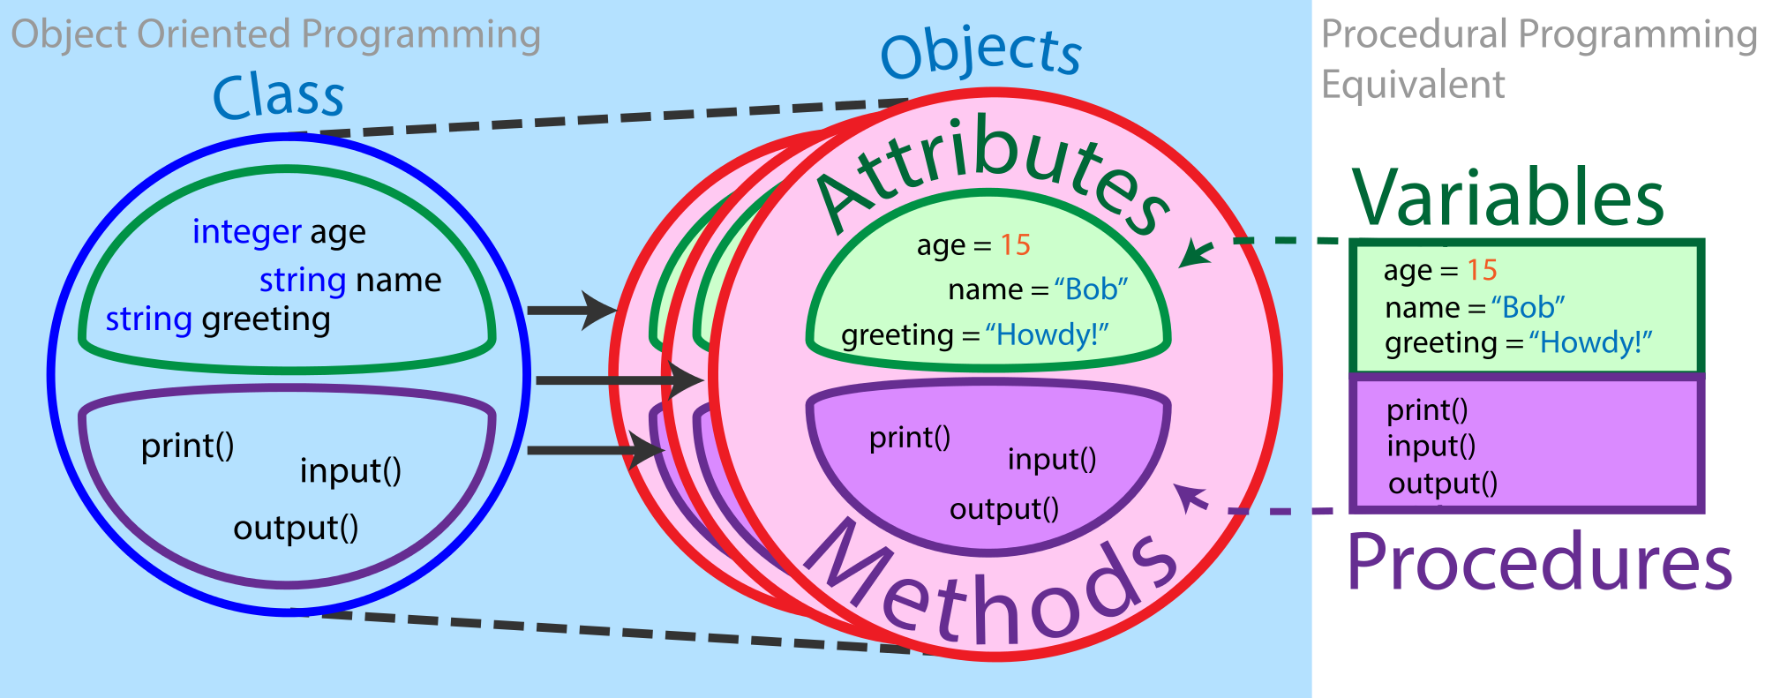
What Are The Components Of Object Oriented Programming?

Slide 24
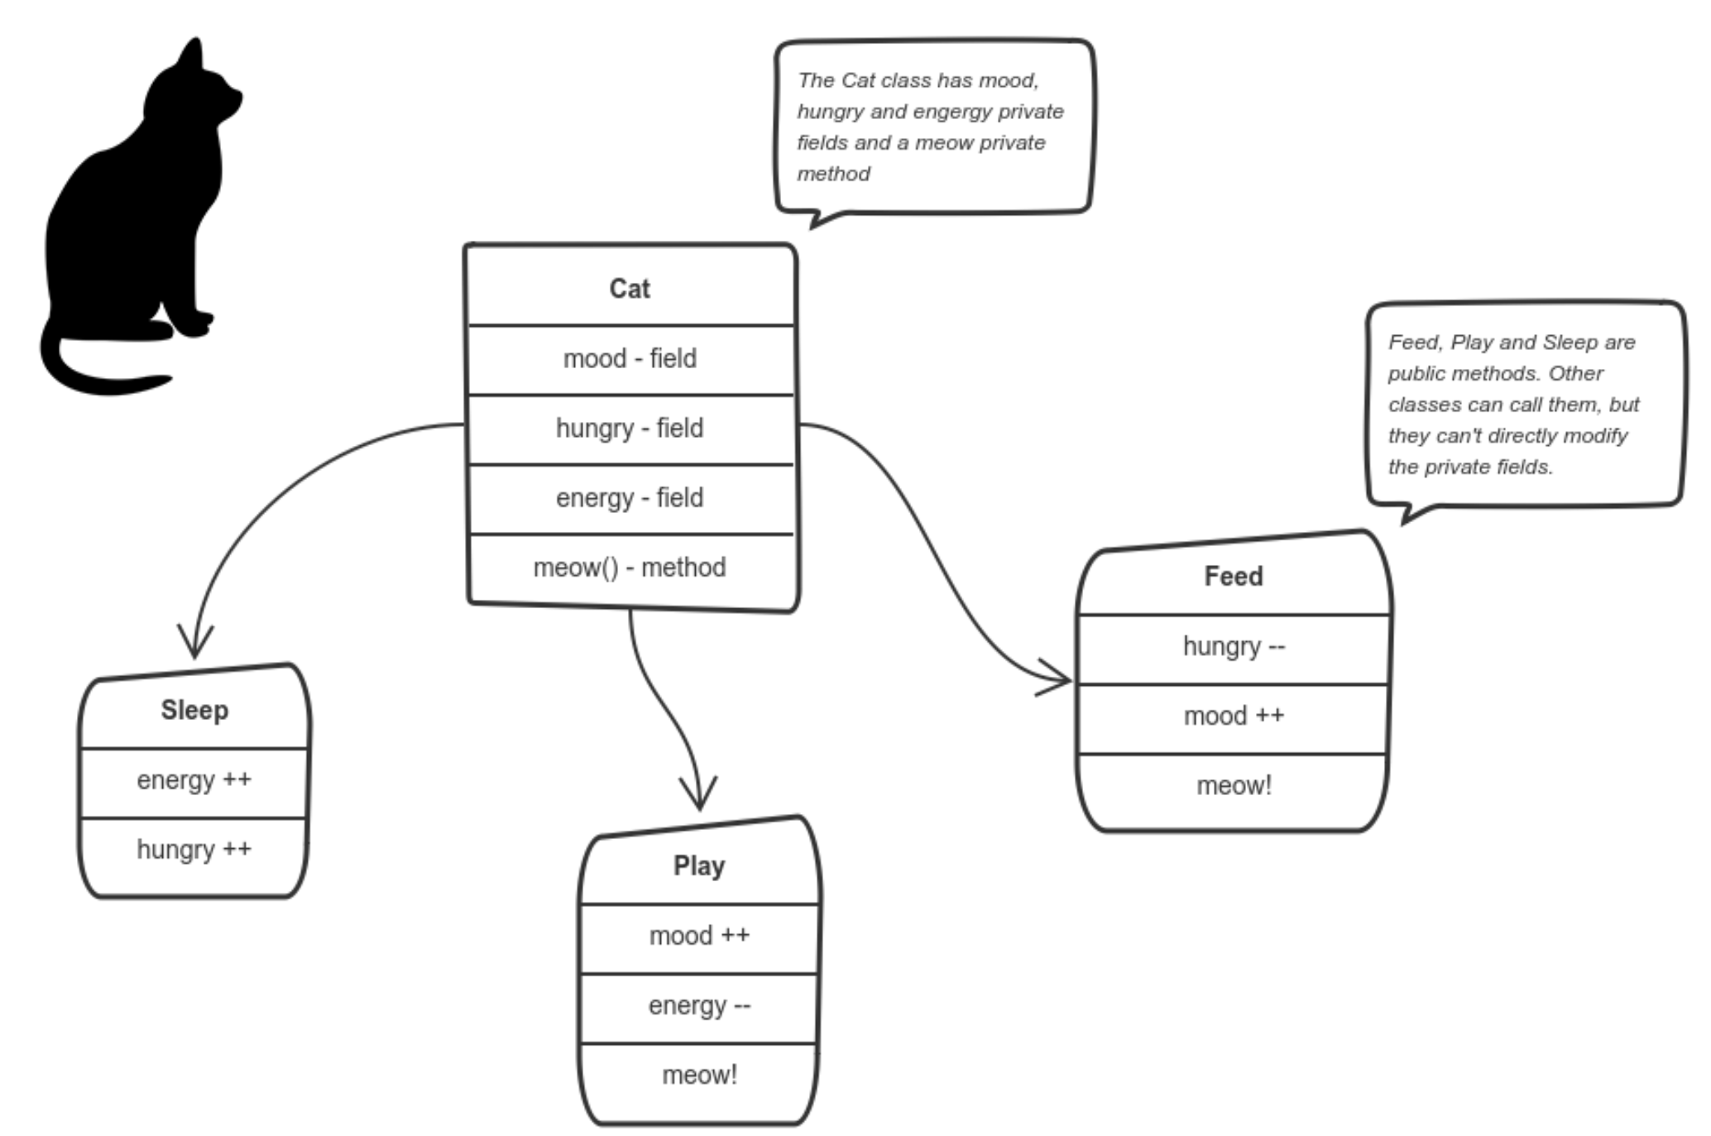
Object Oriented Programming (OOP)
Encapsulation
Abstraction
Inheritance
Polymorphism
https://medium.freecodecamp.org/object-oriented-programming-concepts-21bb035f7260

Slide 25
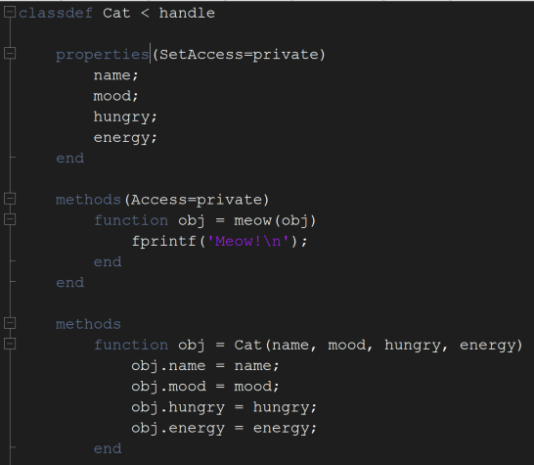
What Does This Mean Programmatically

Slide 26
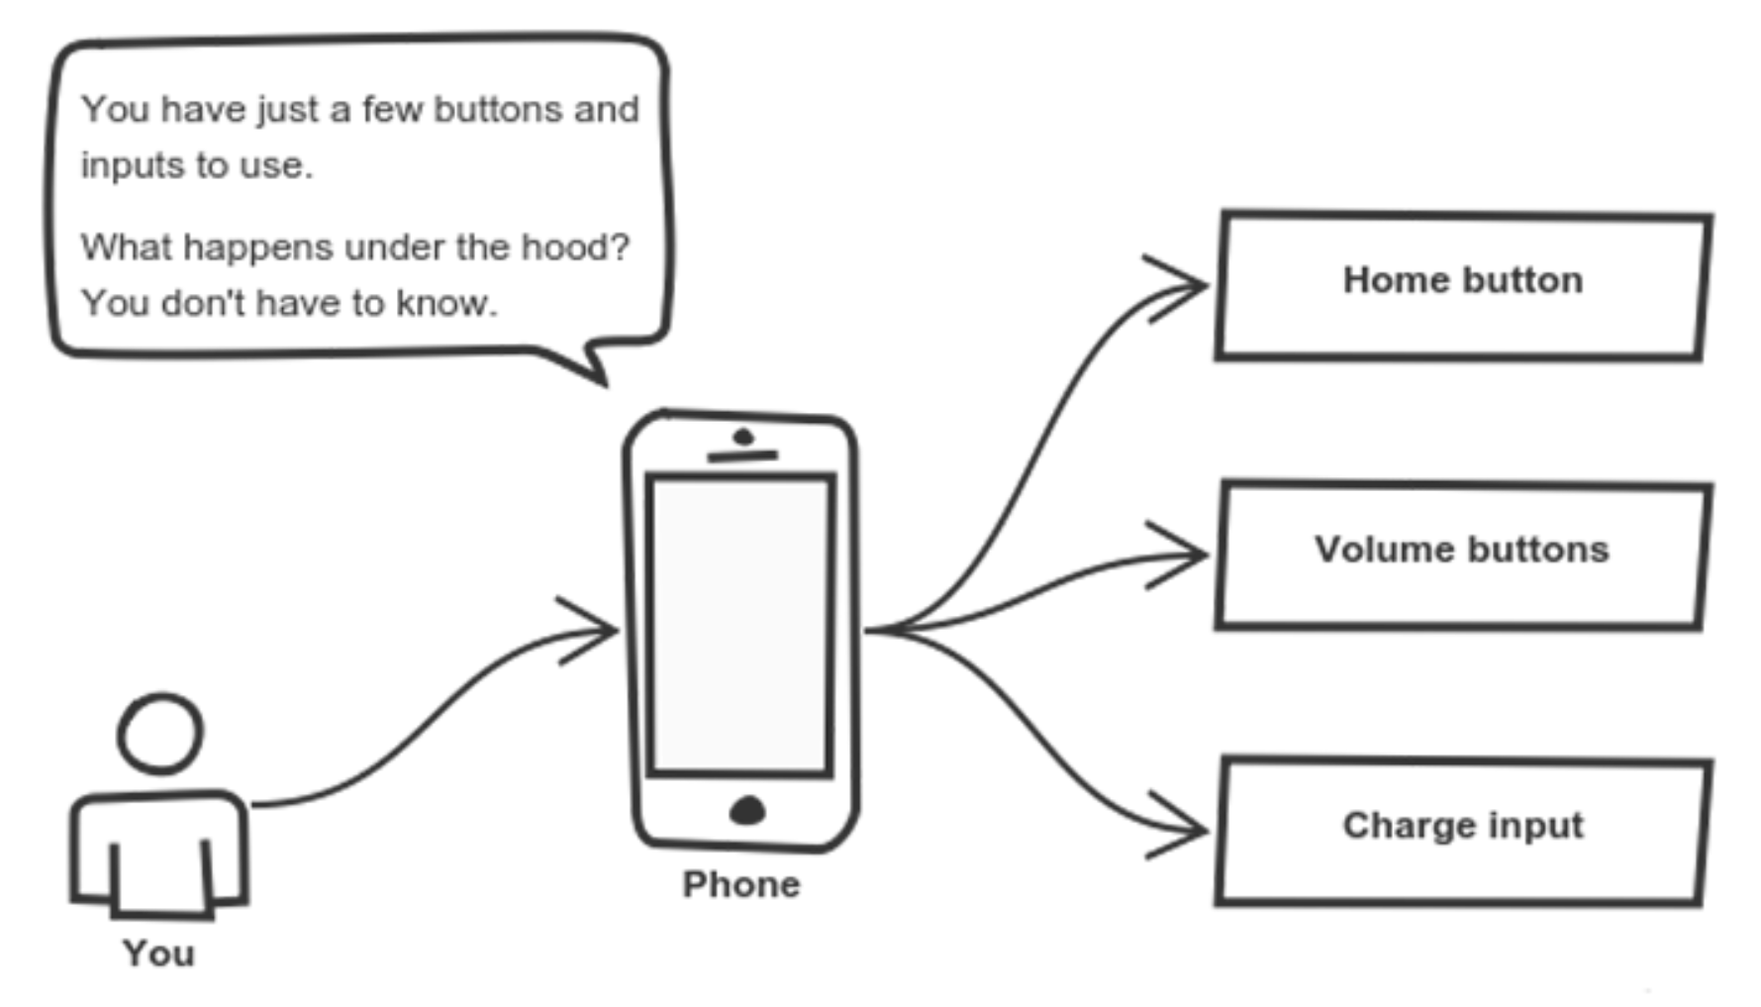
Object Oriented Programming (OOP)
Encapsulation
Abstraction
Inheritance
Polymorphism
https://medium.freecodecamp.org/object-oriented-programming-concepts-21bb035f7260

Slide 27
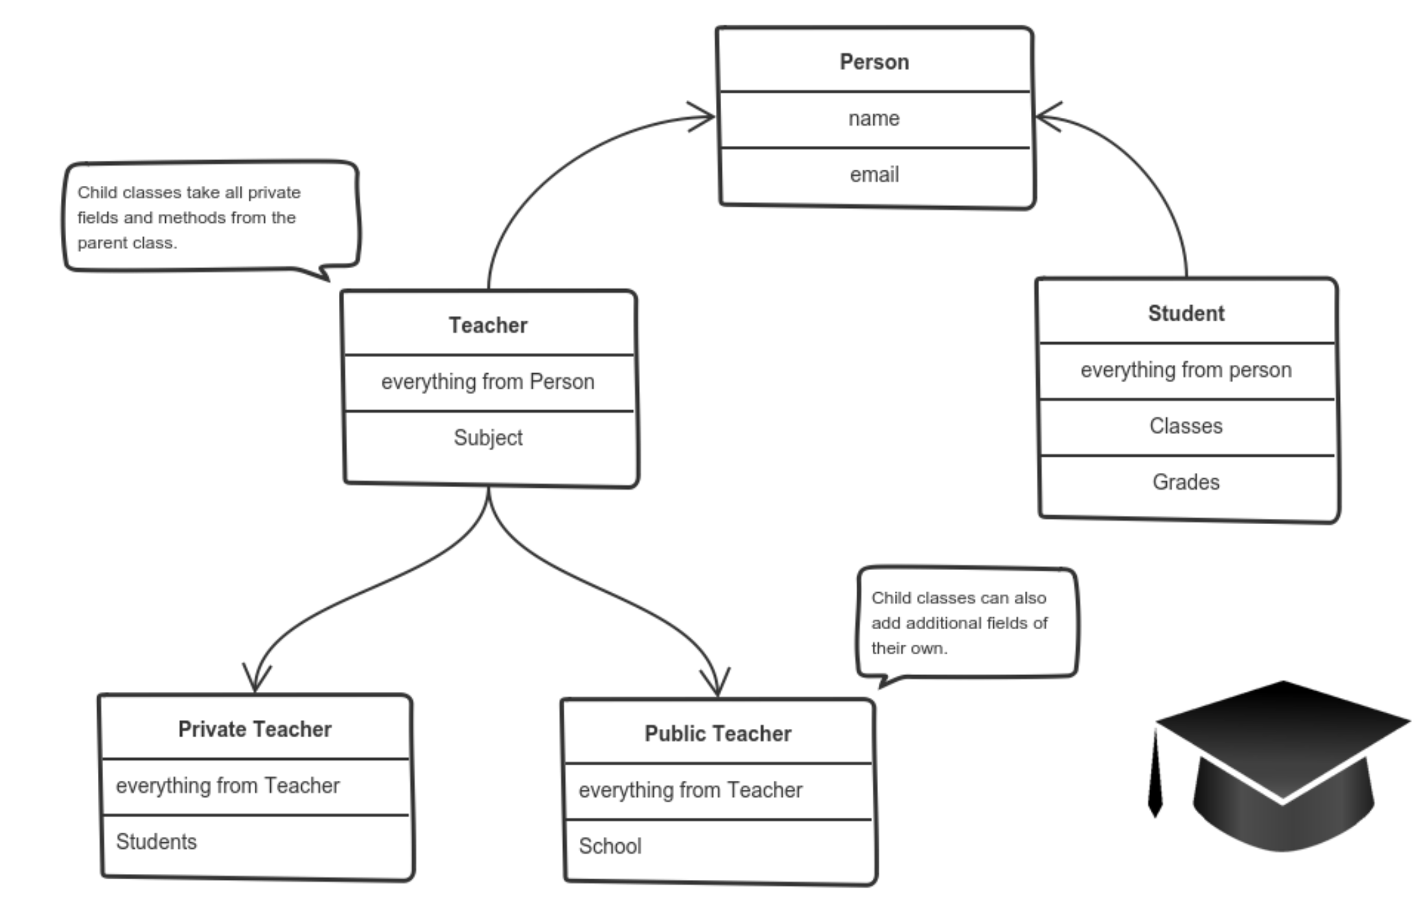
Object Oriented Programming (OOP)
Encapsulation
Abstraction
Inheritance
Polymorphism
https://medium.freecodecamp.org/object-oriented-programming-concepts-21bb035f7260

Slide 28
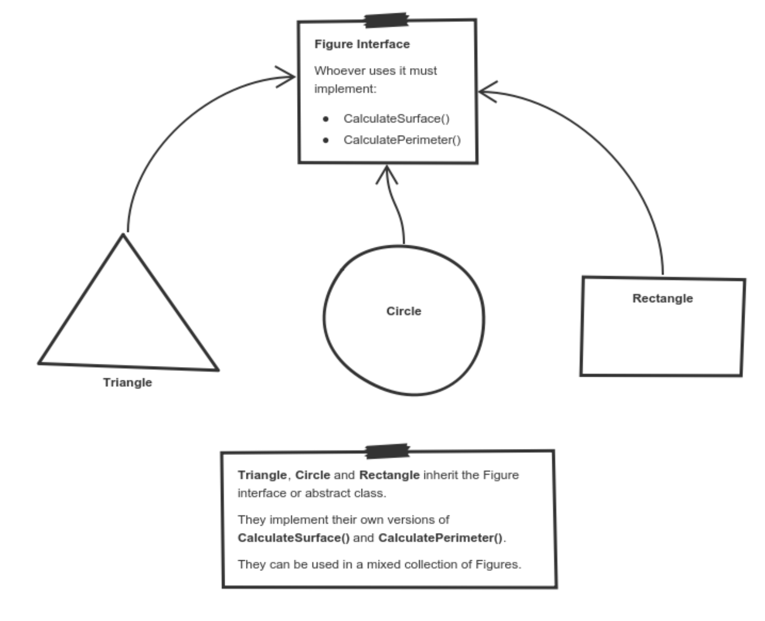
Object Oriented Programming (OOP)
Encapsulation
Abstraction
Inheritance
Polymorphism
https://medium.freecodecamp.org/object-oriented-programming-concepts-21bb035f7260

Slide 29
We’ve Made A Lot Of Changes To Our Code!
Let’s Commit Them To GitHub!

Slide 30
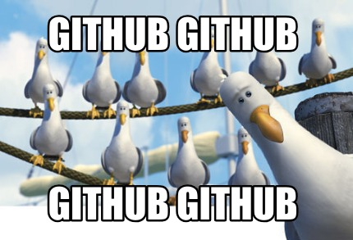
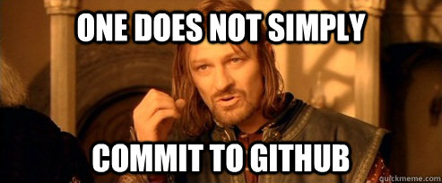
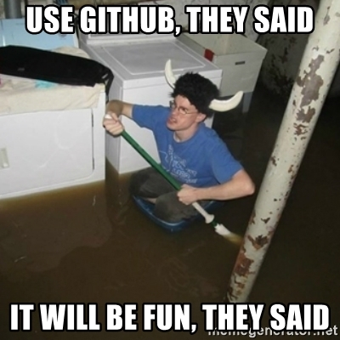



Slide 32
How Do I Make Sure My Local Repo Is Up-To-Date With My Local Workspace?
You need to again cd to your local git repo using the terminal
$ cd /path/to/git/repo/
Add file to be committed to the local repo
$ git add <filename>
Add all files in directory with:
$ git add .
Commit the files to the local repo
$ git commit -m "Comment About Commit"

Slide 33
Now That I Have My Local Repo Caught Up, How Do I Add Changes To Remote Repo (GitHub)?
You need to again cd to your local git repo using the terminal
$ cd /path/to/git/repo/
Push changes to remote repo
$ git push origin master

Slide 34
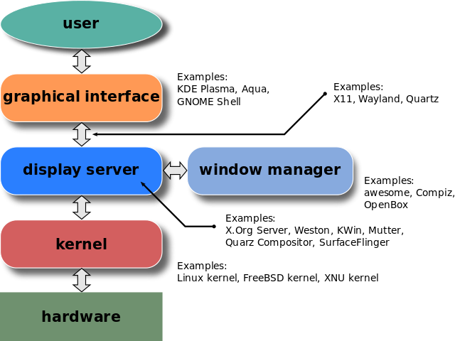
How Can We Make Code Interfaces Easier To Use?

Slide 35
Why Would We Use A Graphical User Interface (GUI)?
They allow for input control
They allow complex procedures to occur at the push of a button
Accessibility to code interface

Slide 36
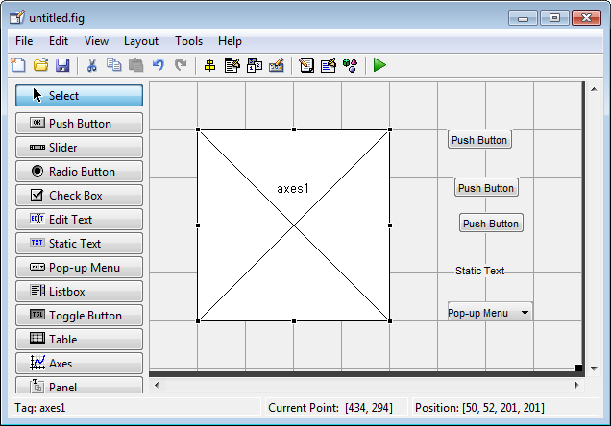
That’s Neato! How Can I Build A GUI Using MatLab?
MatLab offers a package called “guide” which is essentially a GUI for… well, making GUIs

Slide 37
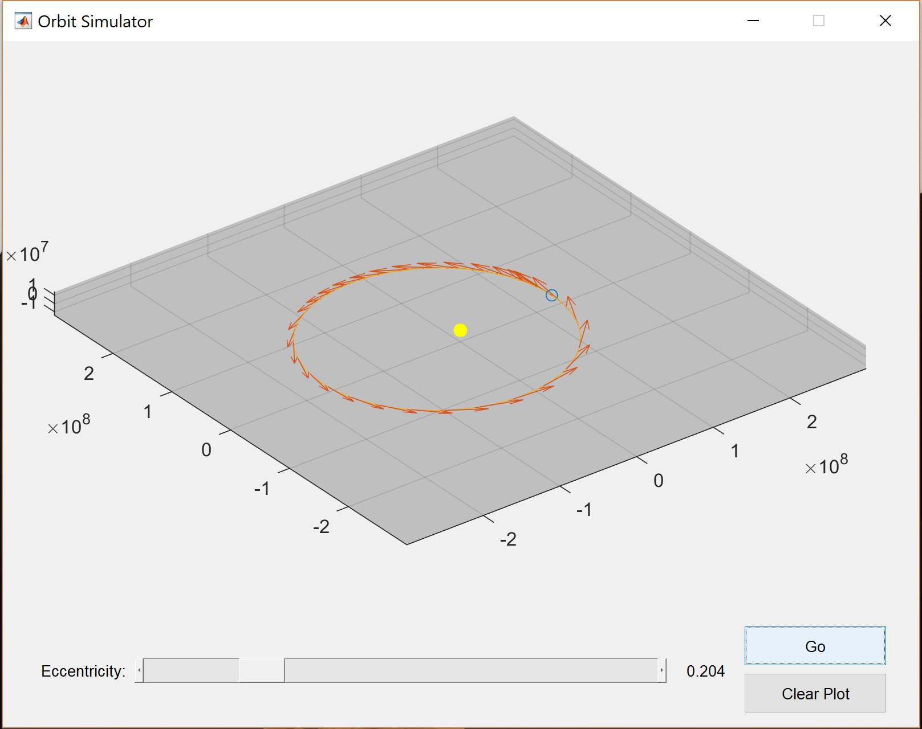
Example: Orbit Plotter

Slide 38
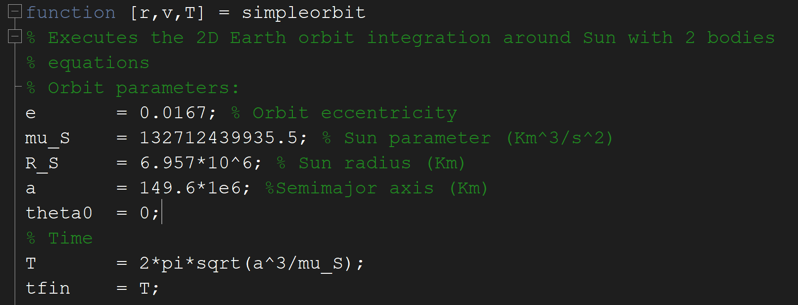
Source Code Is Provided By NASA
~/GUIWorkspaces/src/simpleorbit.m

Slide 39
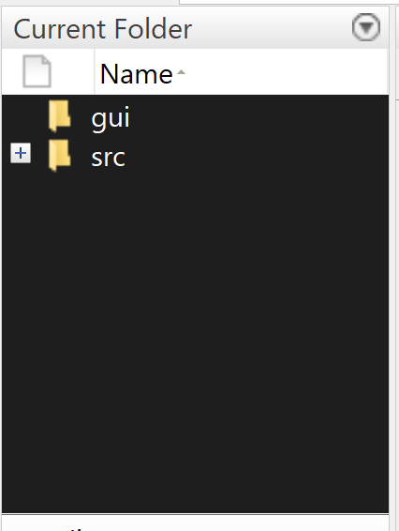
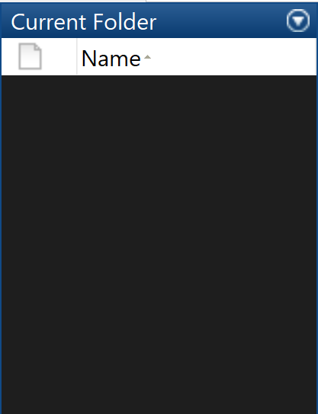
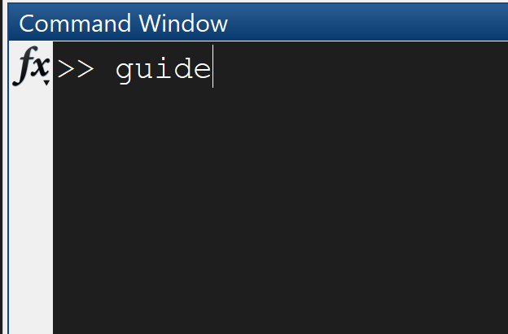
Setup
1. Create GUI Directory
2. Go to “gui” directory
3. Type “guide” in to Command Window

Slide 40
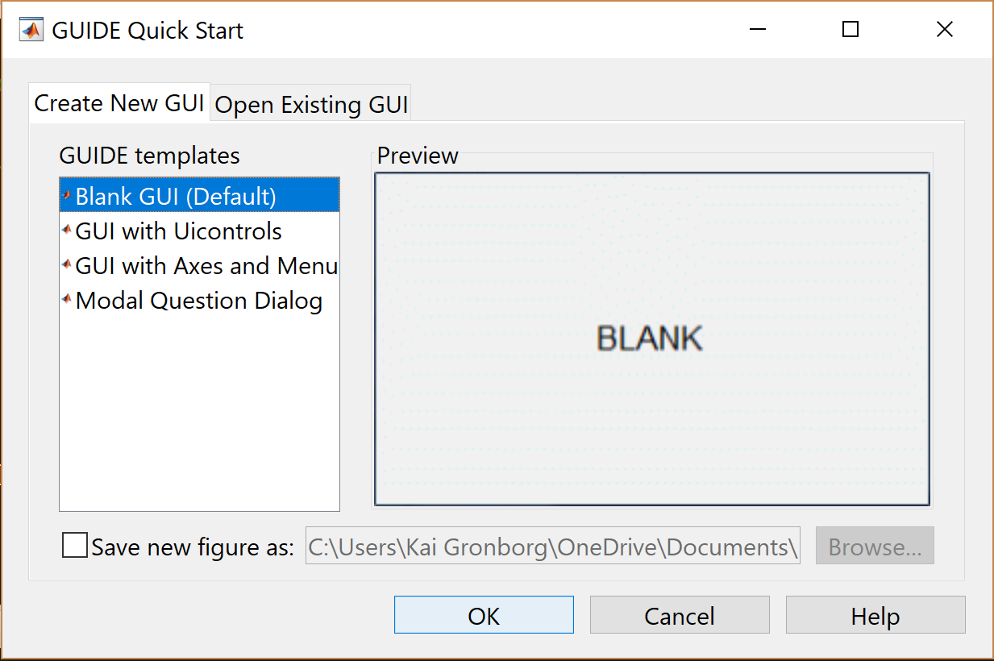
Select Blank GUI; Click OK!!

Slide 41
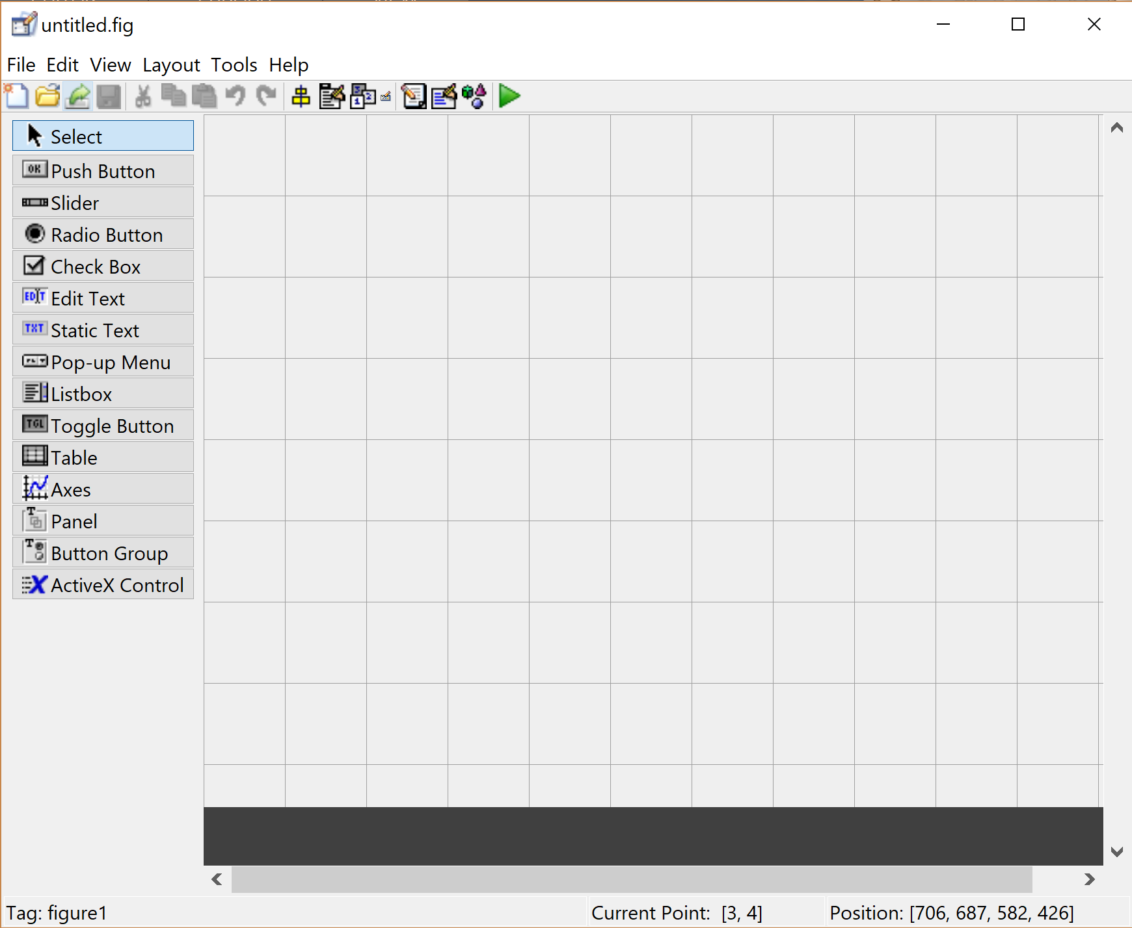
This is a guide layout designer…it’s super cool, Right?
Component Palette:
These are the available GUI components!
Layout Area:
Where you put the GUI components

Slide 42
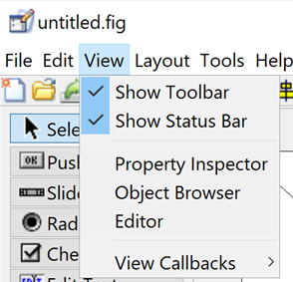
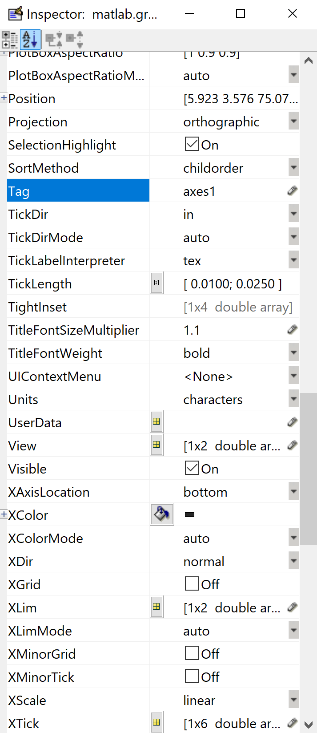
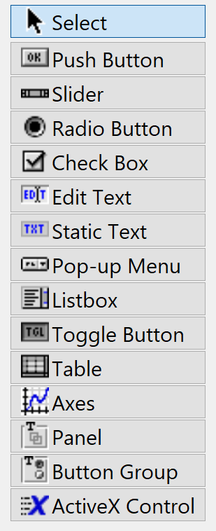
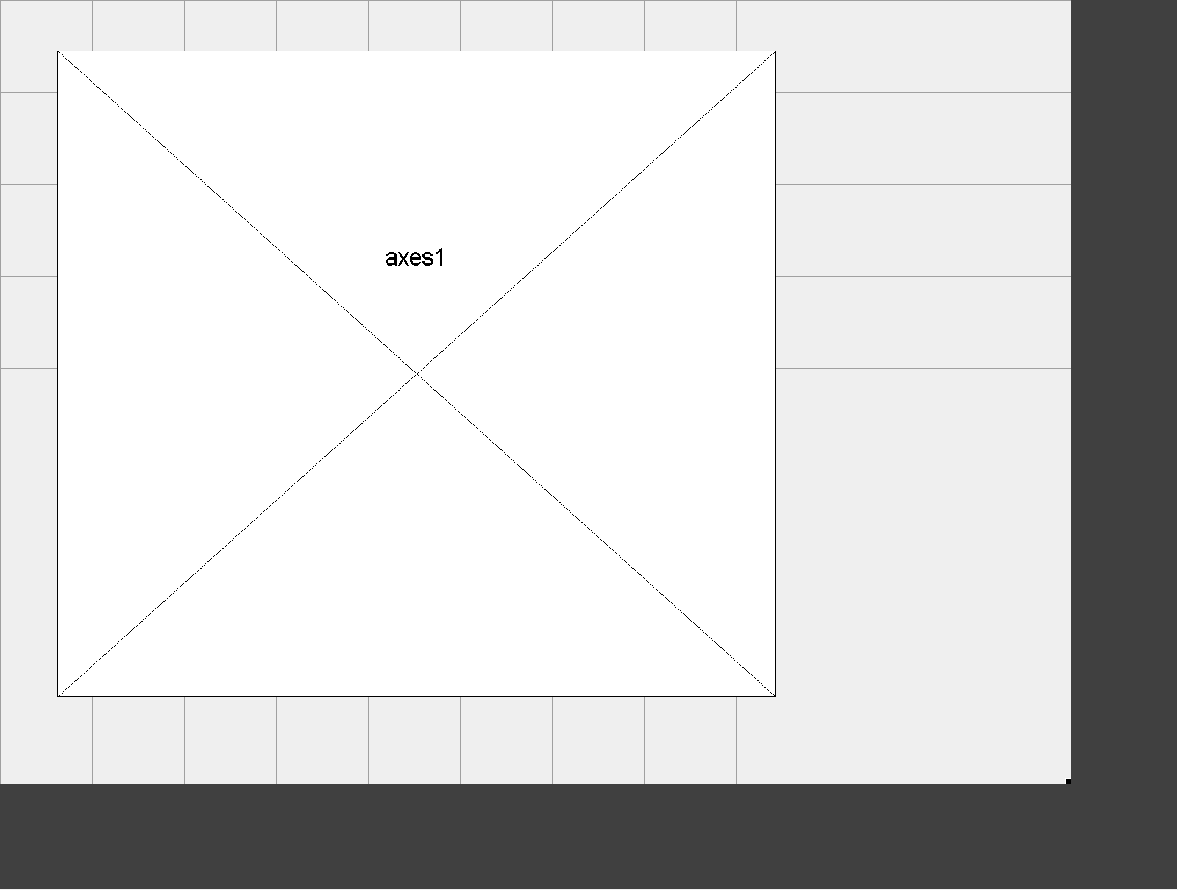
Let’s add a plot! (or as guide call it “Axes”)
Draw “Axes” in Layout area
Click
Change Tag to something you can remember
Click Here

Slide 43
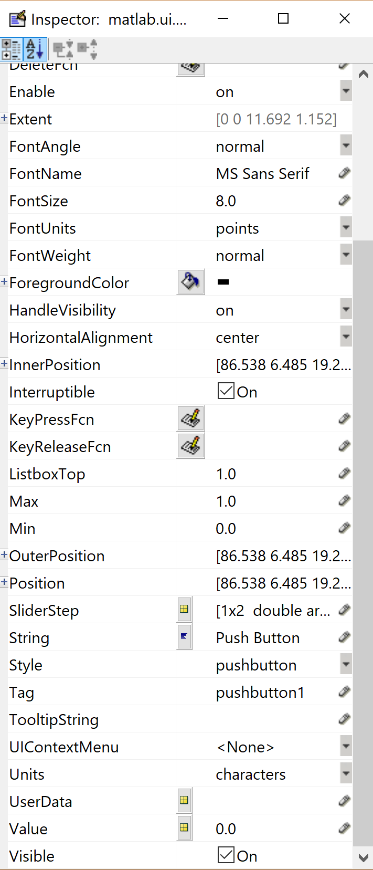
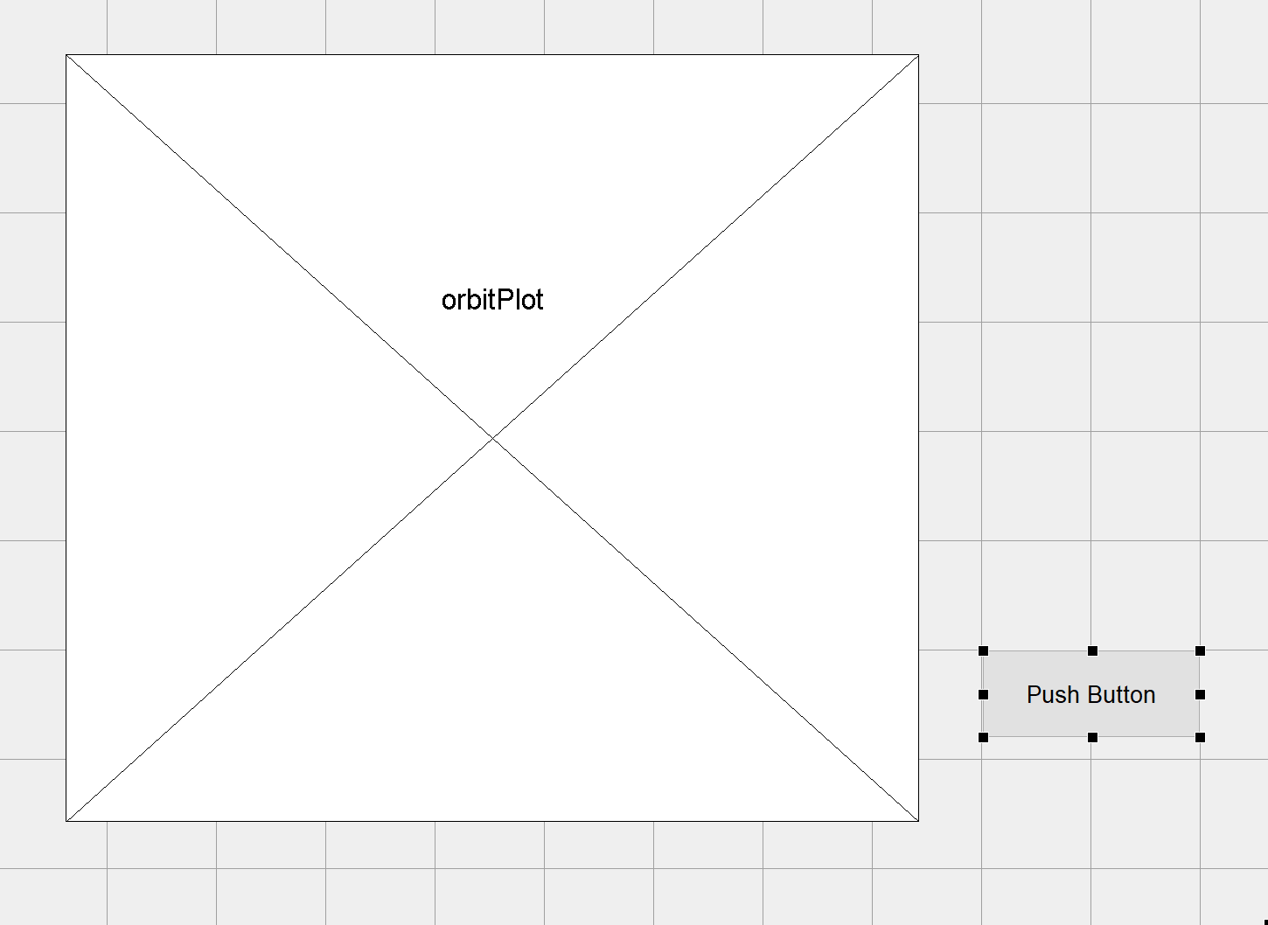
Add a Button!
Draw “Push Button”
Click Here
Click
Change Tag to something you can remember

Slide 44
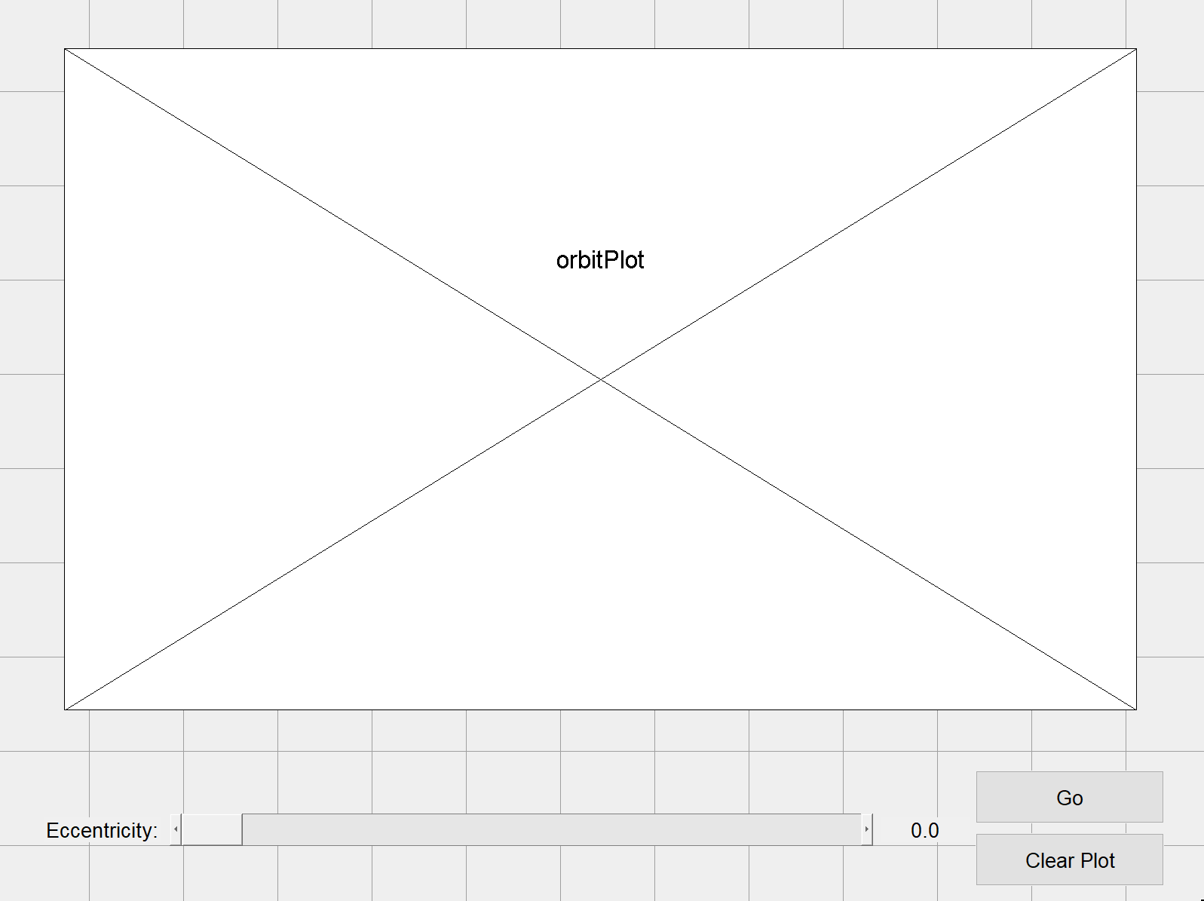
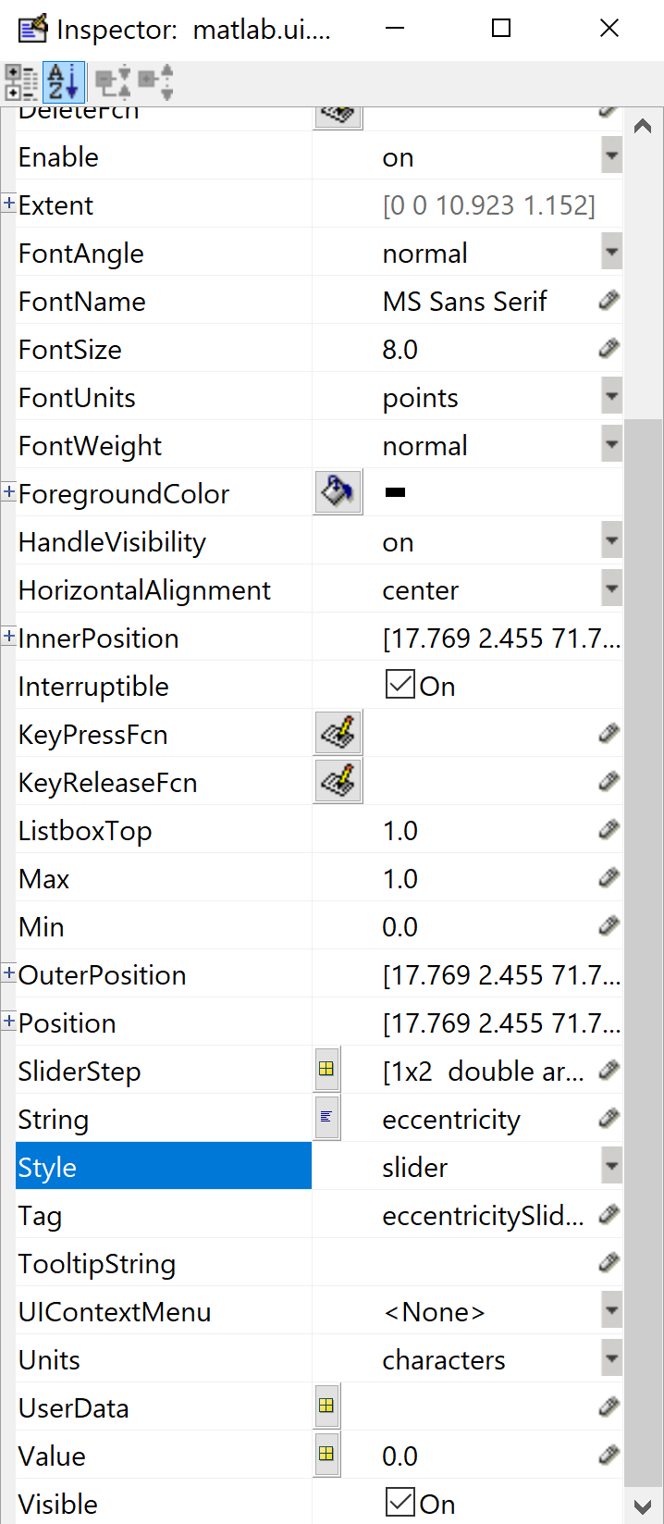
Let’s add some other components and arrange them and edit their properties

Slide 45
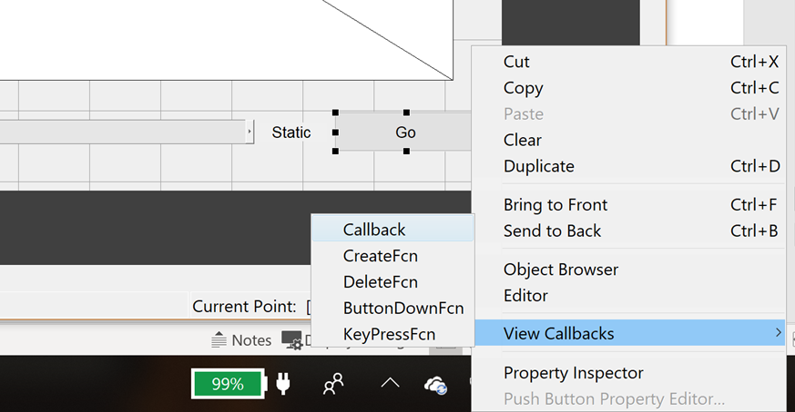
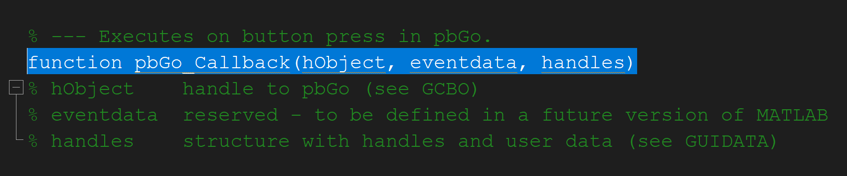
Ooookk, So we have a nice looking GUI but how do we make it do stuff?

Slide 46
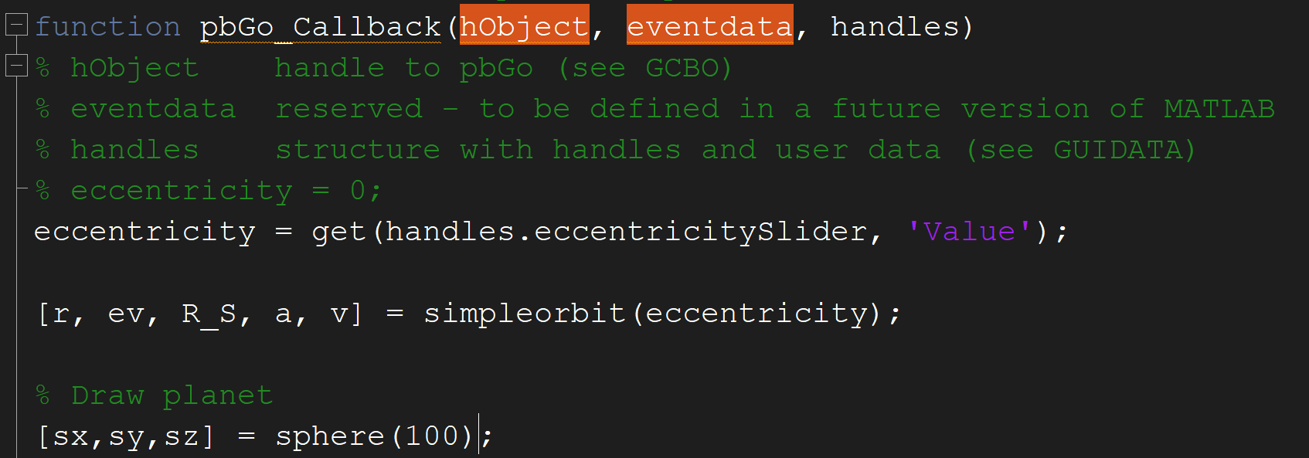
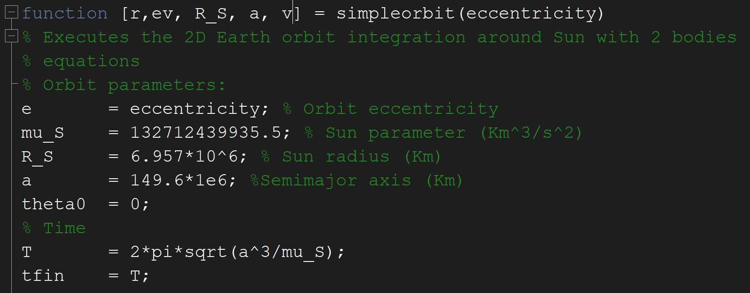
Code Behavior of GUI and Edit simpleorbit.m to work with GUI

Slide 47
Thank you!

